Slide 1
JSON-LD and NSGI-LD
Why organizations need linked data solutions

Slide 2
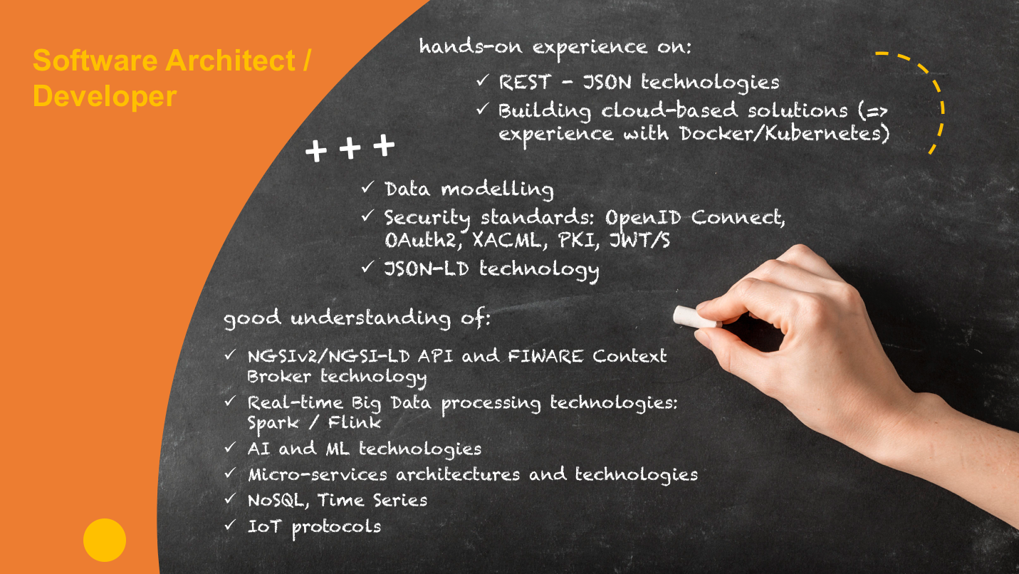
Profile
Notes:
As a reminder to participants these profiles are best suited for training. The DIHs have to appoint person(s) for 2 roles, namely - Ambassadors and LEBDs. It is upto DIHs to appoint one or more person(s) for each role, having said that, they can also appoint same person to both roles.
The DIHs play key role during the open call and during the running of experiments. The DIHs are expected during open call to activate SMEs in their network and discuss potential solution using i4Trust with SMEs to make them data driven. The solution should be to share data in the value chain the SME is (or want to be) part of. The Ambassadors from DIHs would have to think ahead of SMEs and help them see the future based on the possibilities i4Trust presents for SMEs. This would need the Ambassadors to have business oriented profile who understand the strategic, business and value potentials in the domain they operate in and use that to activate SMEs to participate in i4Trust so unlock its potential. Additionally, the DIHs can also pre-define the challenges they know SMEs are already facing and define the challenges such that SMEs can understand and relate to it.
During the implementation of experiments the LEBDs are expected to support SMEs in all the phases of implementation. They are expected to provide technical support to the development teams of SMEs so that they can make sure that the technical components of i4Trust fits well within the architecture of SMEs and can function inline with the purpose of experimentation and beyond. Since this is crucial for the success of the experiments itself especially after they are in actual use and even more crucial for the sustainability of i4Trust itself, the LEBDs are expected to understand the inner workings of the critical components that i4Trust brings. Since these are developed using specific technologies the LEBDs should be well versed in technologies that are mentioned above in the profile. Given that LEBDs are expected to be both business oriented and technically well versed, we believe that it would be usually 2 persons with different backgrounds. Having said that it is not mandatory to have 2 persons as 1 person can also fulfil both the roles as well. This is left to DIHs to determine if they want to appoint 1 or more persons (more then 2 is also possible) to be LEBDs.

Slide 3
FIWARE in a nutshell
FIWARE is an open source initiative defining a universal set of standards for context data management which facilitate the development of smart solutions.
REST done right
Standard mapping of HTTP verbs and status codes
JSON payloads plus some additional structure rules
Registrations to augment context
Publish/Subscribe mechanism for asynchronous processing

Slide 4
Real-time processing of context events (Perseo)
Creation of
Application Dashboards (Wirecloud)
Real-time Processing of
media streams (Kurento, OpenVidu)
Cloud Edge (FogFlow)
NGSI Context Broker Implementations
(Orion, Orion-LD,
Scorpio, Stellio)
Publication and Monetization of
Context Information (CKAN extensions, Data/API Biz Framework, IDRA)
Context Processing, Analysis, Visualization
Development of
Context-aware Applications
(STH-Comet, Cygnus,
QuantumLeap, Draco)
Core Context Management (Context Broker)
Data/API Management
Publication Monetization
Deployment Tools
Handling
authorization and
access control to APIs (Keyrock, Wilma,
AuthZForce, APInf )
Interface to IoT, Robotics and
Third Party Systems
Big Data Context Analysis (Cosmos)
Documents
Exchange (Domibus)
Connection to
External Systems (Oliot)
Connection to IoT (IoT Agents, OpenMTC)
Connection to Robots (FIROS, Fast DDS,Micro XRCE-DDS)

Slide 5
NGSI v2 already exists, why bother with NGSI-LD?
I like the idea of:
No vendor lock-in
Adding an interoperability layer between processes and the real world
Flexible architectures
Powered by FIWARE Solutions
FIWARE Ready Devices
FIWARE Ready Enablers
etc.
I’ve already gained those advantages, so what comes next?

Slide 6
My data is useful to me, but is more powerful shared with others
… but what about Conway's law?
Any organization that designs a system (defined broadly) will produce a design whose structure is a copy of the organization's communication structure.
— Melvin E. Conway
… how can I share data and benefit from other organizations if their organization “communicates” differently?

Slide 7
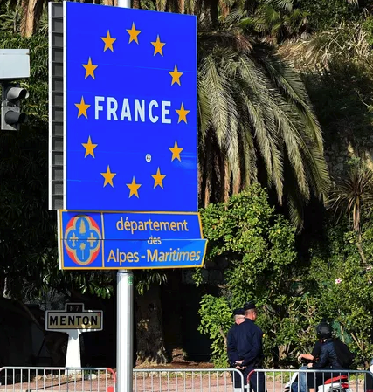
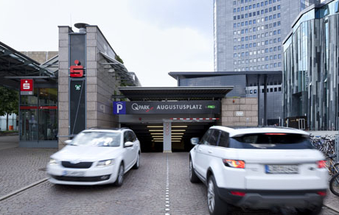
Illustrative FIWARE Examples
Car Parking
Cross-border Tourism

Slide 8

Linked Data: JSON to JSON-LD
From: https://json-ld.org/
JSON-LD is a lightweight Linked Data format. It is easy for humans to read and write. It is based on the already successful JSON format and provides a way to help JSON data interoperate at Web-scale.
Linked Data empowers people that publish and use information on the Web. It is a way to create a network of standards-based, machine-readable data across Web sites. It allows an application to start at one piece of Linked Data, and follow embedded links to other pieces of Linked Data that are hosted on different sites across the Web.
{
"@context": "https://json-ld.org/contexts/person.jsonld",
"@id": "http://dbpedia.org/resource/John_Lennon",
"name": "John Lennon",
"born": "1940-10-09",
"spouse": "http://dbpedia.org/resource/Cynthia_Lennon"
}

Slide 9

Harpreet Singh, the Blockchain in Smart Cities Expert

Slide 10
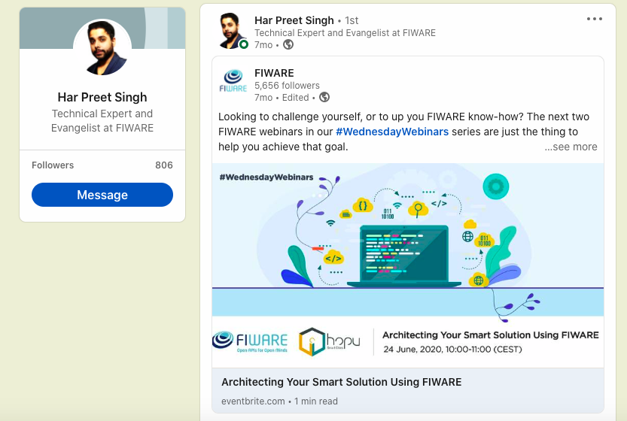
Harpreet Singh, the Blockchain in Smart Cities Expert

Slide 11
URL: https://www.linkedin.com/in/singhhp1069/

Slide 12
Linked Data: NGSI v2 to NGSI-LD
From: https://fiware-datamodels.readthedocs.io/en/latest/ngsi-ld_faq/index.html
NGSI-LD is an evolution of the FIWARE NGSI v2 information model, and has been updated/improved to support linked data (entity relationships), property graphs and semantics (exploiting the capabilities offered by JSON-LD). This work has been conducted under the ETSI ISG Context Information Management initiative.
Creating proper machine-readable Linked Data is fundamental to NGSI-LD.
NGSI-LD Payloads are valid JSON-LD
{
"@context": [
"https://fiware.github.io/data-models/context.jsonld",
"https://uri.etsi.org/ngsi-ld/v1/ngsi-ld-core-context.jsonld"
],
"id": "http://dbpedia.org/resource/John_Lennon",
"type": "Person",
"name": {"type": "Property", "value": "John Lennon"},
"born": {"type": "Property", "value": "1940-10-09"},
"spouse": {"type": "Relationship", "object": "http://dbpedia.org/resource/Cynthia_Lennon" }
}

Slide 13
NGSI-LD Properties: Creating an Entity
NGSI v2
NGSI-LD
curl -iX POST 'http://localhost:1026/v2/entities' \
-H 'Content-Type: application/json' \
-d '{
"type": "Store", "id": "store001",
"category": { "type": "Array", "value": ["commercial"]},
"address": { "type": "PostalAddress", "value": {
"streetAddress": "Bornholmer Straße 65",
"addressRegion": "Berlin",
"addressLocality": "Prenzlauer Berg",
"postalCode": "10439"
},
"metadata": {
"verified": { "type": "Boolean","value": true}
}
},
"location": {"type": "geo:json",
"value": {"type": "Point", "coordinates": [13.3986, 52.5547]}
},
"name": {"type": "Text", "value": "Bösebrücke Einkauf"}
}'
curl -iX POST http://localhost:1026/ngsi-ld/v1/entities \
-H 'Content-Type: application/ld+json' \
-d '{
"type": "Building", "id": "urn:ngsi-ld:Building:store001",
"category": { "type": "Property", "value": ["commercial"]},
"address": { "type": "Property"," value": {
"streetAddress": "Bornholmer Straße 65",
"addressRegion": "Berlin",
"addressLocality": "Prenzlauer Berg",
"postalCode": "10439"
},
"verified": { "type": "Property", "value": true }
},
"location": { "type": "GeoProperty",
"value": { "type": "Point", "coordinates": [13.3986, 52.5547]}
},
"name": { "type": "Property", "value": "Bösebrücke Einkauf" },
"@context": [
"https://fiware.github.io/data-models/context.jsonld",
"https://uri.etsi.org/ngsi-ld/v1/ngsi-ld-core-context.jsonld"
]
}'

Slide 14
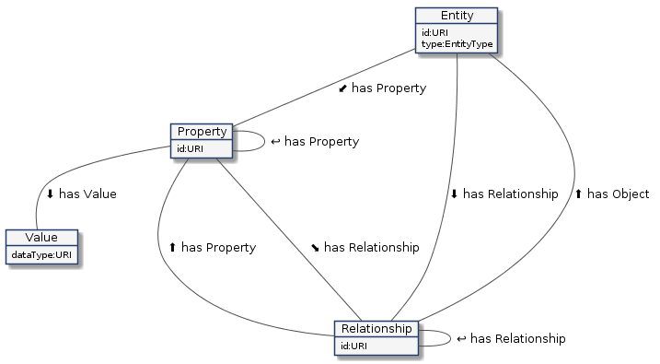

NGSI-LD Properties: Data Model
NGSI-LD
Entities
Properties
Relationships
Values
plus …
plus …
etc...
The NGSI LD data model is more complex; the definitions of use are more rigid which lead to a navigable knowledge graph.
NGSI v2
Entities
Attributes
MetaData
Properties of Properties
Properties of Relationships
Relationships of Properties
Relationships of Relationships
.
Properties of Properties of Properties
Relationships of Properties of Properties
Properties of Properties of Relationships
Relationships of Properties of Relationships
Properties of Relationships of Properties
Relationships of Relationships of Properties
Properties of Relationships of Relationships
Relationships of Relationships of Relationships

Slide 15
NGSI-LD Properties: Data Model
The Entity | Example | Notes
Has an id | urn:ngsi-ld:Building:store001 | URI/URN. id must be unique.
Has a type. | https://uri.fiware.org/ns/ data-models#Building | Fully qualified URI of a well defined data model Short-hand strings for types, mapped to fully qualified URIs through the JSON-LD @context.
Has a series of properties | name, address, category etc. | This can be expanded into http://schema.org/address, which is known as a fully qualified name (FQN).
Has a series of properties-of-properties | a verified field for the address | This is the equivalent of NGSI v2 metadata
Has a series of relationships | managedBy | The object corresponds to the URI/URN of another data entity. Equivalent of NGSI v2 refXXX
Has a series of properties-of-relationships | managedBy.since | Holds additional information about a relationship. This is the equivalent of metadata about a refXXX property
Has a series of relationships-of-relationships | managedBy.subordinateTo | holds the URI/URN of another relationship.

Slide 16
NGSI-LD Properties: Reading Entity Data
NGSI-LD
Response is just a JSON payload plus an @context
@context can be passed either in the Link header
or the payload body:
Accept: application/ld+json to include
the @context as a JSON attribute
Accept: application/json returns plain old
JSON objects - @context is passed as a Link header
Just a minute what has happened to category?
curl -G -X GET \
'http://localhost:1026/ngsi-ld/v1/entities' \
-H 'Link: <https://fiware.github.io/data-models/context.jsonld>; rel="http://www.w3.org/ns/json-ld#context"; type="application/ld+json"' \
-H 'Accept: application/ld+json' \
-d 'type=Building' \
-d 'options=keyValues'
[
{
"@context": "https://fiware.github.io/data-models/context.jsonld",
"id": "urn:ngsi-ld:Building:store001", "type": "Building",
"address": {
"streetAddress": "Bornholmer Straße 65",
"addressRegion": "Berlin",
"addressLocality": "Prenzlauer Berg",
"postalCode": "10439"
},
"name": "Bösebrücke Einkauf",
"category": [
"https://uri.fiware.org/ns/data-models#commercial"
],
"location": {
"type": "Point", "coordinates": [13.3986, 52.5547]
}
}
]

Slide 17
NGSI-LD Properties: What to call a location?
location
locatedAt
geocoordinate
geocoordinates
place
ubicación
standort
置き場所
NGSI-LD core @context
"@context": {
"ngsi-ld": "https://uri.etsi.org/ngsi-ld/",
"id": "@id",
"type": "@type",
"value": "https://uri.etsi.org/ngsi-ld/hasValue",
"object": {
"@id": "https://uri.etsi.org/ngsi-ld/hasObject",
"@type": "@id"
},
"Property": "https://uri.etsi.org/ngsi-ld/Property"
"Relationship": "https://uri.etsi.org/ngsi-ld/Relationship",
... etc.
"unitCode": "https://uri.etsi.org/ngsi-ld/unitCode",
"location": "https://uri.etsi.org/ngsi-ld/location",
... etc.
}
With NGSI-LD core @context a location is always https://uri.etsi.org/ngsi-ld/location

Slide 18
NGSI-LD Properties: @vocab and Enumerated Values
With NGSI-LD Data Models, attributes and enums are well-defined in a computer-readable fashion
FIWARE Data Models @context
"@context": {
"type": "@type",
"id": "@id",
"schema": "https://schema.org/",
"fiware": "https://uri.fiware.org/ns/data-models#",
... etc.
"address": "schema:address",
"category": {
"@id" :"fiware:category",
"@type": "@vocab"
},
"commercial": "fiware:commercial",
"office": "fiware:office",
"retail": "fiware:retail",
"residential": "fiware:residential",
... etc.
}
An “address” is:
https://schema.org/address
A “category” is:
https://uri.fiware.org/ns/data-models#category
A category is an enum which takes a
set of values such as:
https://uri.fiware.org/ns/data-models#commercial
https://uri.fiware.org/ns/data-models#office
https://uri.fiware.org/ns/data-models#retail
https://uri.fiware.org/ns/data-models#residential
enum is in progress.

Slide 19
Useful links
JSON-LD
Website: https://json-ld.org/
Linked Data Video: https://www.youtube.com/watch?v=vioCbTo3C-4
JSON-LD Video: https://www.youtube.com/watch?v=4x_xzT5eF5Q
NGSI-LD
ETSI Specification: https://www.etsi.org/deliver/etsi_gs/CIM/001_099/009/01.03.01_60/gs_cim009v010301p.pdf
NGSI-LD Video: https://www.youtube.com/watch?v=rZ13IyLpAtA
Tutorials: https://ngsi-ld-tutorials.readthedocs.io/
Smart Data Models
Website: http://smartdatamodels.org/
Smart Cities Data Models Video: https://www.youtube.com/watch?v=dfMo0HnaIUQ

